Slide 1

Play with WASM
ZiCheng Zhang
Notes:
大家好，我是shenyu社区的张子成，很高兴在Apache亚洲峰会2024和大家见面。首先感谢Apache基金会提供这个舞台，其次感谢帮助过我的社区小伙伴，接下来让我们进入今天的正题：玩转WASM。

Slide 2

1.Introduction
4.Example
2.Motivation
5.Communication
3.Solution
6.Extention
Notes:
来我们分为4部分来介绍，第1点是关于shenyu及个人的介绍，第2点是shenyu引入WASM技术的动机，在第3点中我们会深入探讨多语言SDK、本地转发、动态链接库和WASM这几种方案之间的优劣，在第4点中讲述了如何在shenyu代理一个http服务，第5点给出了在WASM和java之前传参的示例，而后，有了讲述如何在shenyu中扩展一个WASM插件，最后时间留给QA。

Slide 3
Introduction
https://github.com/loongs-zhang/ACOCA2024-PlayWithWASM
Notes:
本次分享的PPT及相关资源可以在我的github上获取。

Slide 4

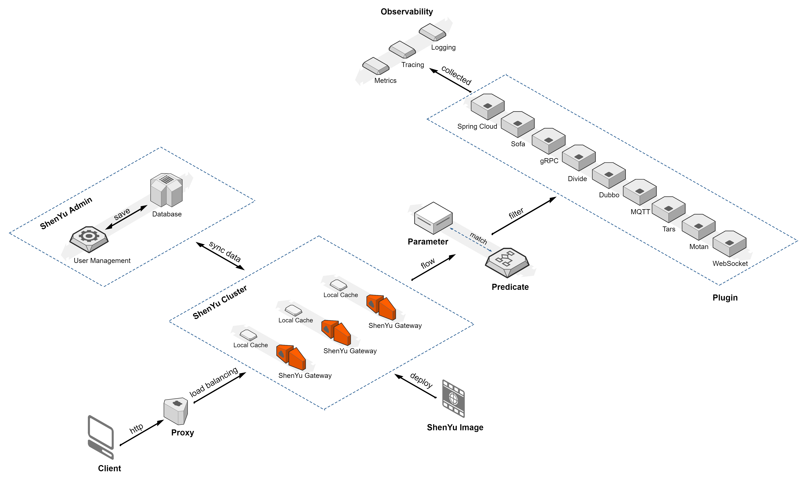
About Apache ShenYu
Apache ShenYu is a Java native API Gateway for service proxy, protocol conversion and API governance.
Notes:
网关、admin、注册中心、

Slide 5
Apache ShenYu Features
* Proxy: Support for Apache® Dubbo™, Spring Cloud, gRPC, Motan, SOFA, TARS, WebSocket, MQTT
* Security: Sign, OAuth 2.0, JSON Web Tokens, WAF plugin
* API governance: Request, response, parameter mapping, RateLimiter plugin
* Observability: Tracing, metrics, logging plugin
* Dashboard: Dynamic traffic control, visual backend for user menu permissions
* Extensions: Plugin hot-swapping, dynamic loading
* Cluster: NGINX, Docker, Kubernetes
* Language: provides .NET, Python, Go, Java client for API register

Slide 6


About Me
https://github.com/loongs-zhang
Apache ShenYu PMC
The founder of open-coroutine project
Contributes in shenyu/dynamic-tp/monoio/dubbo
Java&Rust developer
One of the creators of arthas vmtool
Created MemorySafeLinkedBlockingQueue

Slide 7
Motivation

Slide 8
Why
ShenYu has good extensibility in the Java. However, we can’t extend ShenYu plugin in languages other than Java.

Slide 9
Solution

Slide 10
Evaluation Criteria
Workload: The workload of framework developers
Difficulty: Difficulty for framework developers
User friendliness: User's learning cost
Operation complexity: The complexity of deploying service using this framework

Slide 11
Multiple Language SDKs
Example: https://github.com/apache/dubbo-go
Workload: Huge, each language has its own technology stack
Difficulty: Hard
Extention for new languages: Unsupported
User friendliness: Great
Performance: Great
Operation complexity: No

Slide 12
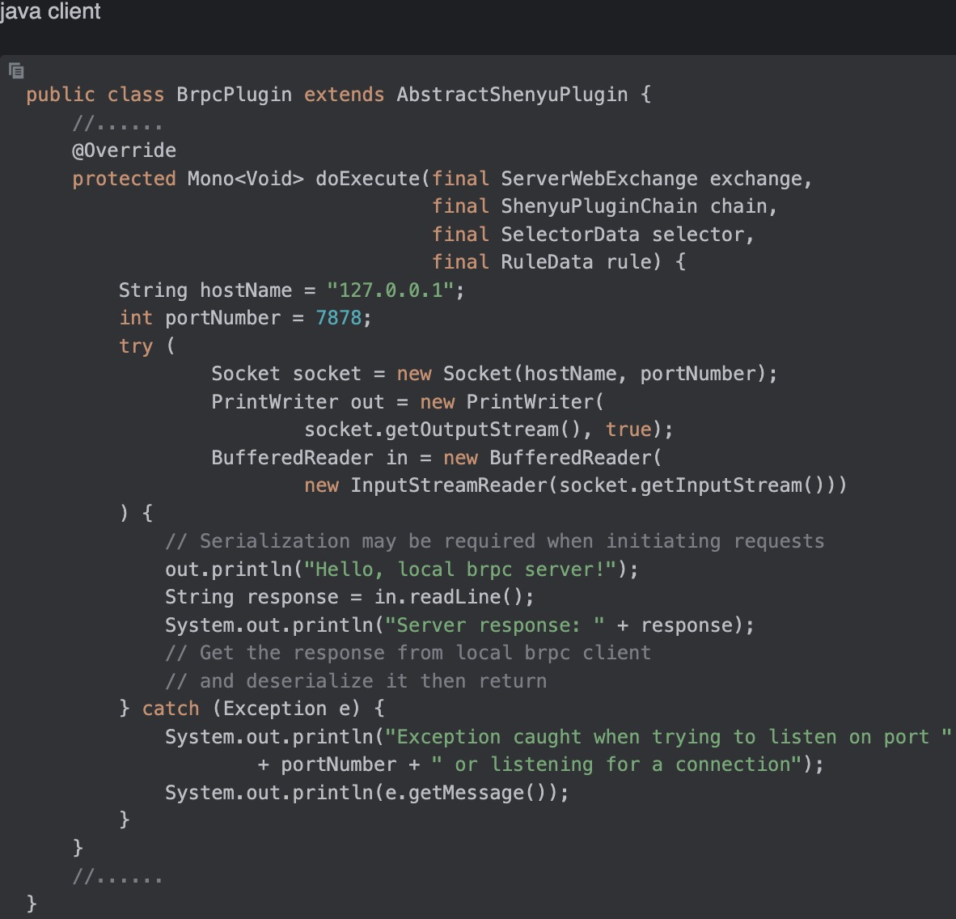
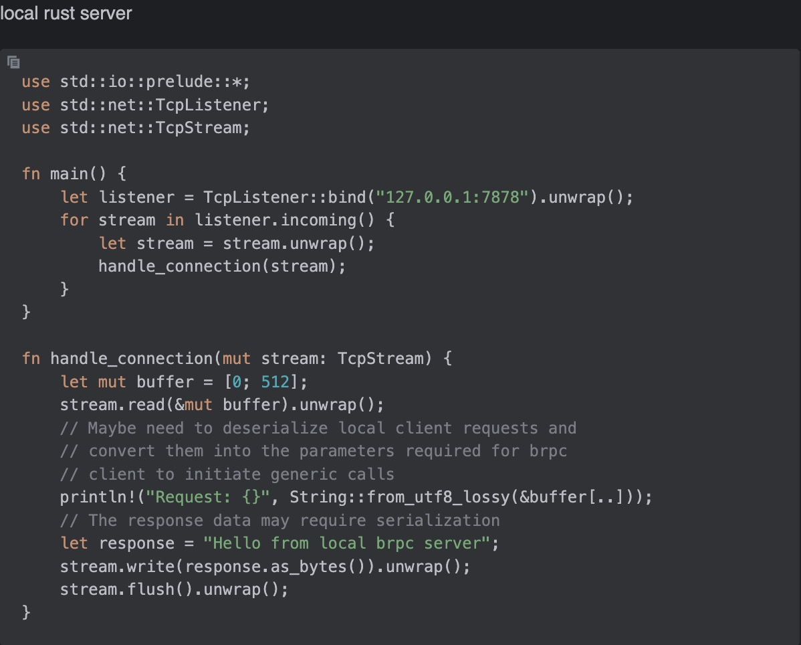
Local Forward Example
This is example for supporting the brpc protocol for shenyu

Slide 13
Local Forward
Example: https://github.com/apache/apisix
Workload: Light
Difficulty: Middle, need to be familiar with network programming
Extention for new languages: Great, no need to modify framework code
User friendliness: Middle, need to be familiar with network programming
Performance: Performance loss due to network protocol stack, serialization and deserialization, at least 20%
Operation complexity: A bit complex, multiple processes need to be started at once on a machine/container

Slide 14
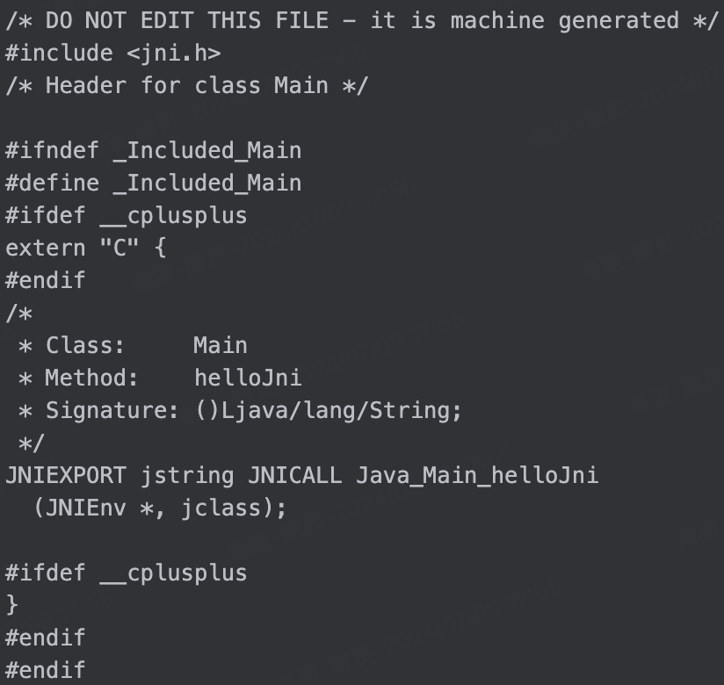
Dynamic Link Library Example
public class Main {
public static native String helloJni();
}
javac -h . Main.java
Then we got Main.h -------------->

Slide 15
Dynamic Link Library Example
// C code below
#include <jni.h>
#include <jni_md.h>
#include <jvmti.h>
#include "Main.h"
JNIEXPORT jstring JNICALL
Java_Main_helloJni (JNIEnv *env,
jclass klass) {
return env->
NewStringUTF("Hello JNI");
}
// generate the dynamic link library by g++ command in macos
g++ -I ${JAVA_HOME}/include
-I ${JAVA_HOME}/include/darwin jni-library.cpp -m64 -fPIC -shared -o jni.dylib

Slide 16
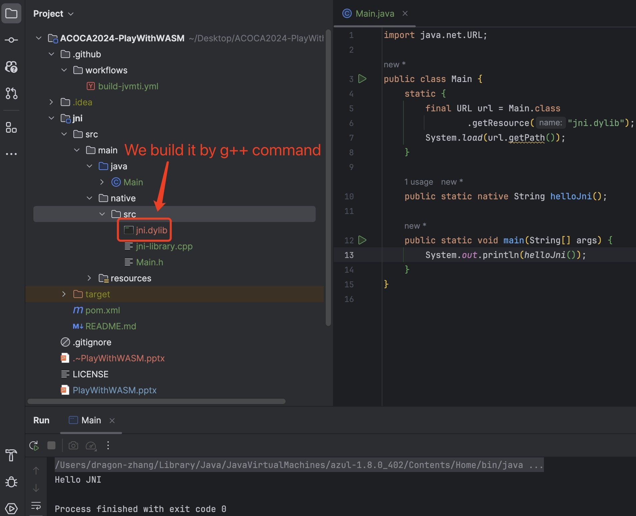
Dynamic Link Library Example
import java.net.URL;
public class Main {
static { final URL url = Main.class.getResource("jni.dylib");
System.load(url.getPath());
}
public static native String helloJni();
public static void main(String[] args) {
System.out.println(helloJni());
}
}
//

Slide 17
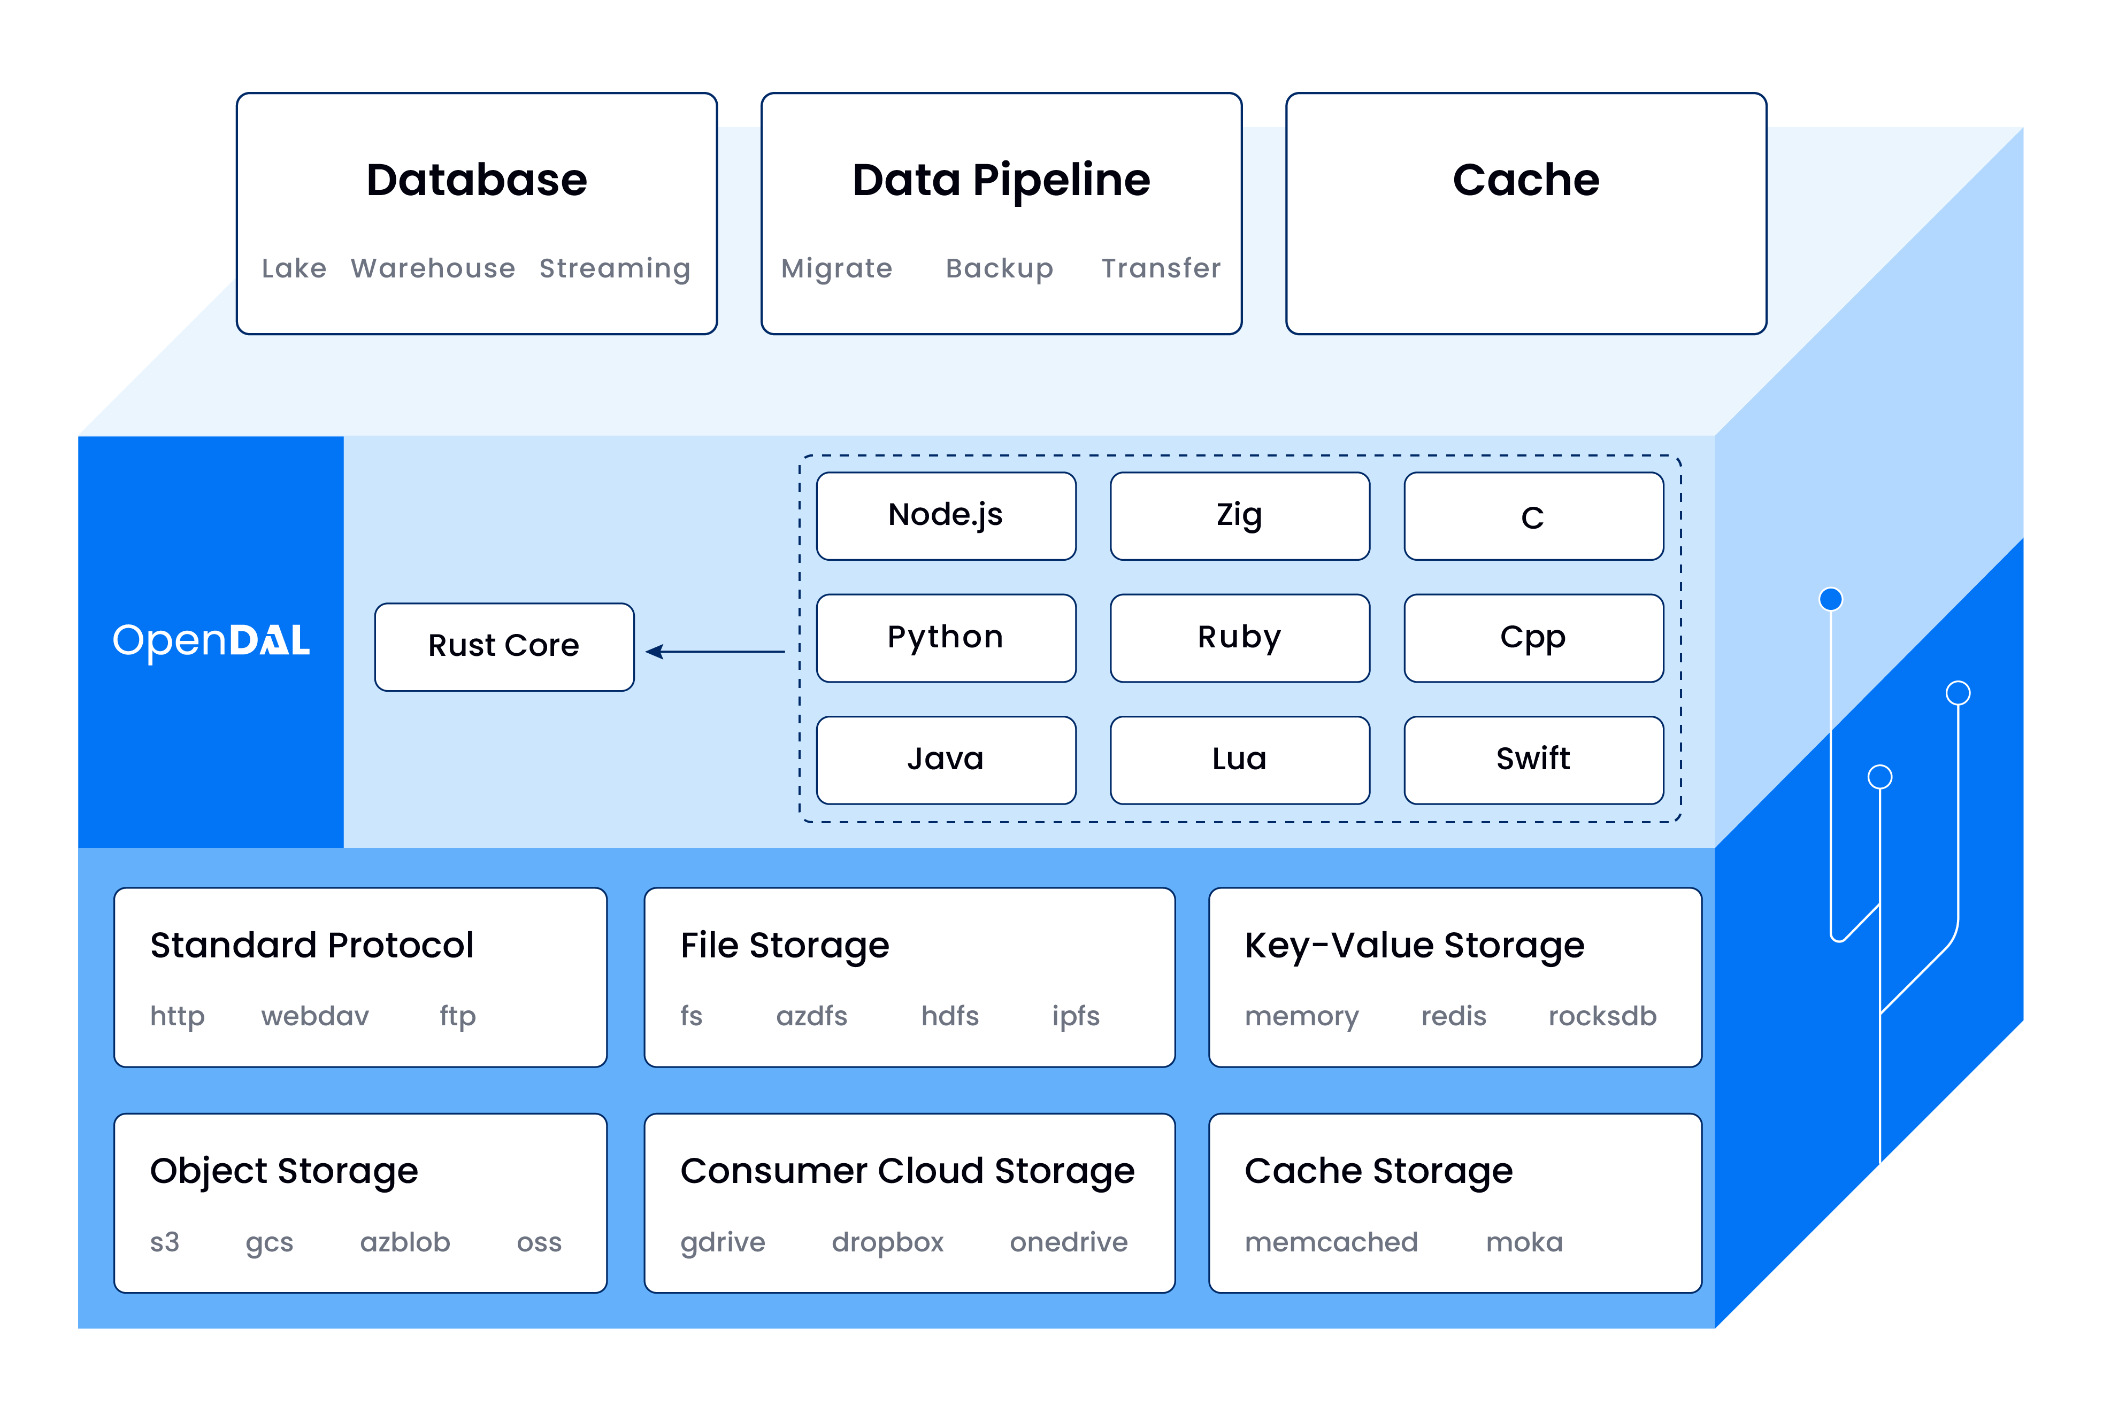
Dynamic Link Library
The low-level code needs to ensure compatibility(OS & CPU);
Each supported language is bound to .so/.dylib/.dll as the upper-level;

Slide 18
Dynamic Link Library
Example: https://github.com/apache/opendal
Workload: Middle
Difficulty: Hard, not only do you need to be familiar with cross platform development, but you also need to learn JNI knowledge in addition
Extention for new languages: Middle, need to encapsulate the dynamic link library for new languages
User friendliness: Good, there is a low probability of discovering that the CPU architecture or OS of your machine is not supported, but if it is, a disaster occurs
Performance: Great
Operation complexity: No

Slide 19
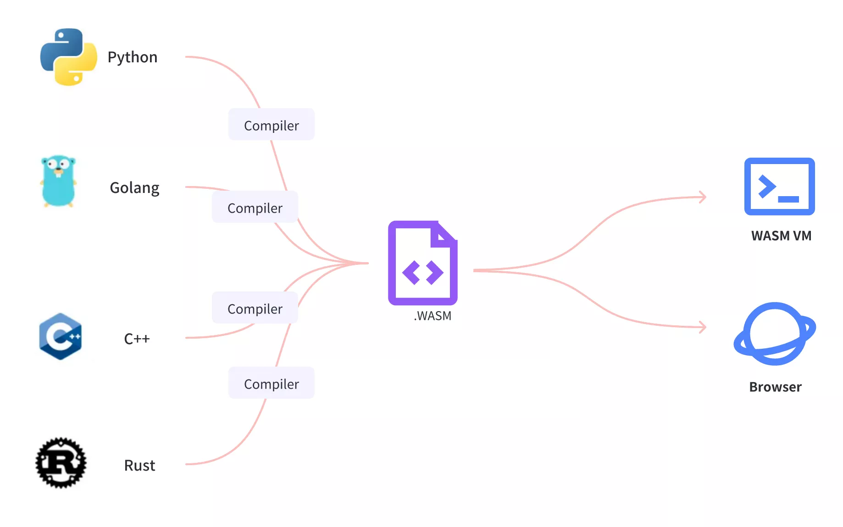
WebAssembly System Interface
WebAssembly or wasm is a new, portable, size- and load-time-efficient format suitable for compilation to the web.
WASI allows WASM to run in non browser environments such as Linux.

Slide 20
WebAssembly System Interface
Example: https://github.com/alibaba/higress
Workload: Light
Difficulty: Simple
Extention for new languages: Good, no need to modify framework code, but it's possible that the language you're good at doesn't support WASM
User friendliness: Good, only 4 basic Java types are supported due to the immaturity of the WASM ecosystem in Java
Performance: Performance loss due to serialization, deserialization and WASI VM
Operation complexity: No

Slide 21
Comparation
 | Example | Workload | Difficulty | Extention | Friendliness | Performance | Complexity
SDKs | dubbo-go | huge | hard | unsupported | great | great | no
Local Forward | apisix | light | middle | great | middle | network, serialization, deserialization | start processes
Native Library | opendal | middle | hard | middle | good | great | no
WASI | higress | light | simple | good | good | serialization, deserialization, WASI VM | no

Slide 22
Example
Notes:
接下来是一个在shenyu代理http服务的例子

Slide 23
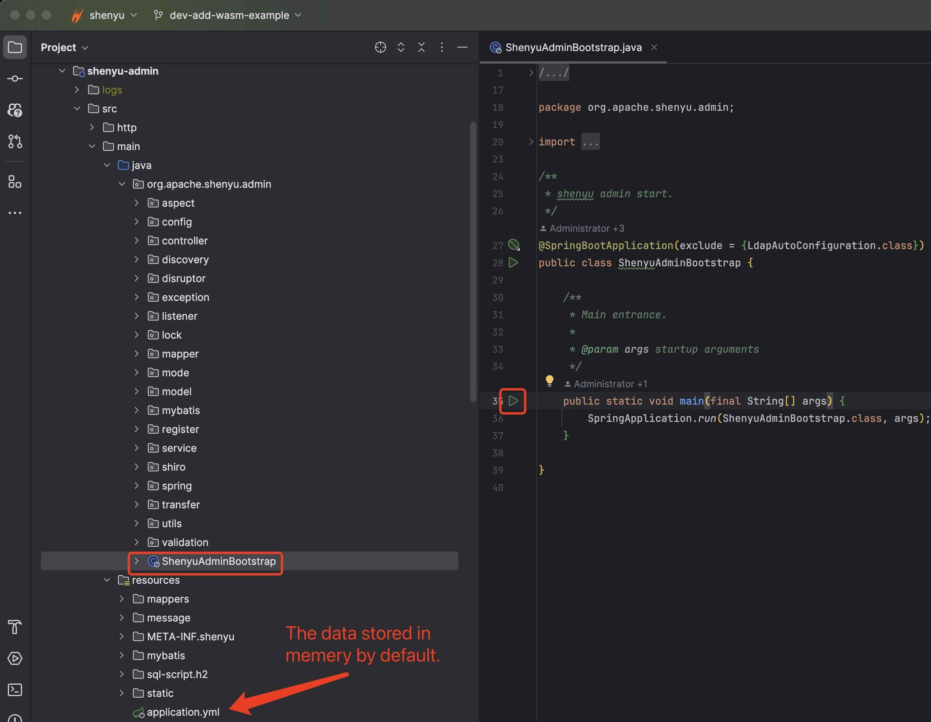
Deploy shenyu-admin
https://shenyu.apache.org/docs/next/deployment/deployment-before

Slide 24
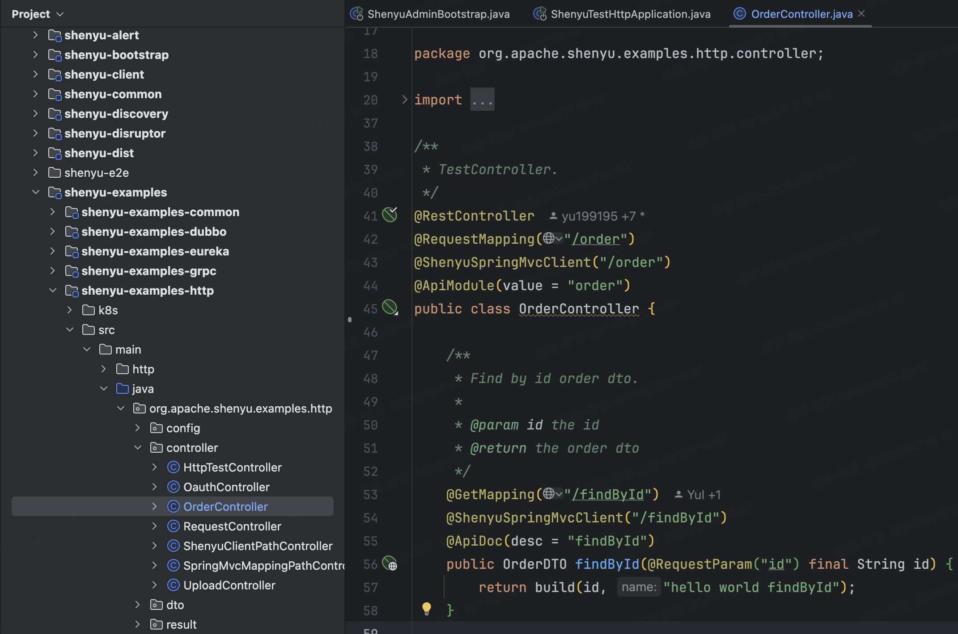
Deploy shenyu-examples-http
https://shenyu.apache.org/docs/next/quick-start/quick-start-http

Slide 25
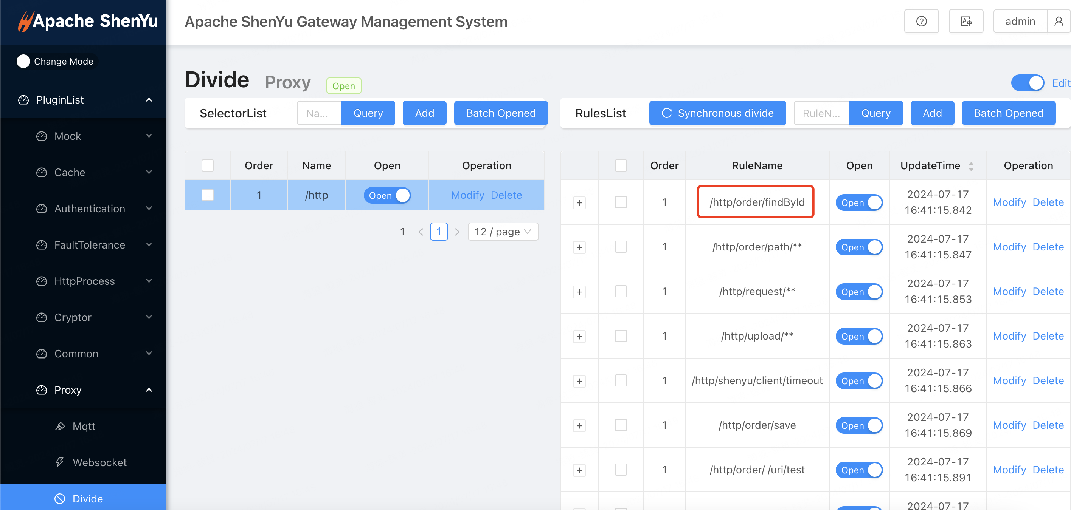
Registered Selector and Rules
https://shenyu.apache.org/docs/next/quick-start/quick-start-http

Slide 26
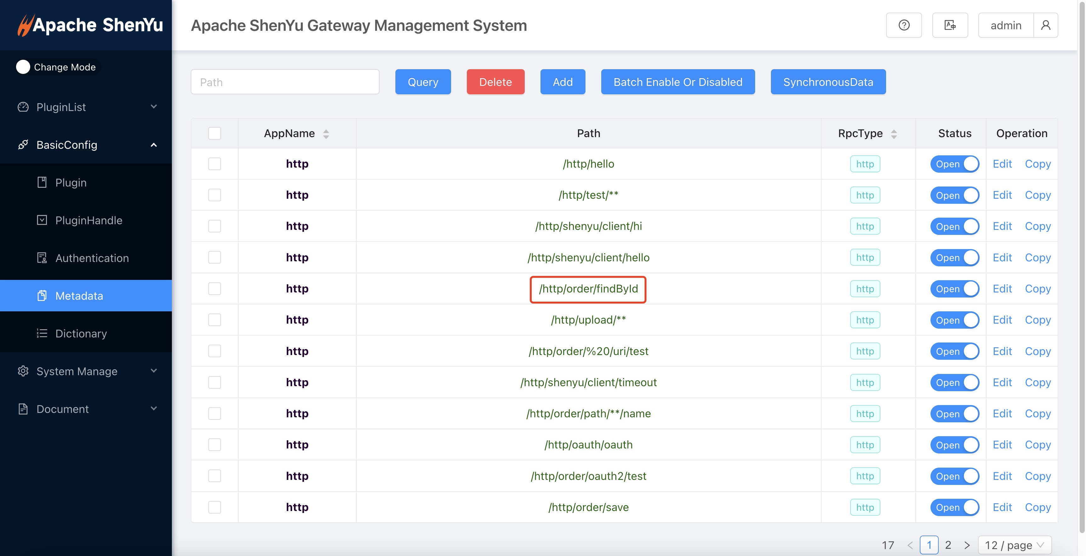
Registered Metadata
https://shenyu.apache.org/docs/next/quick-start/quick-start-http

Slide 27
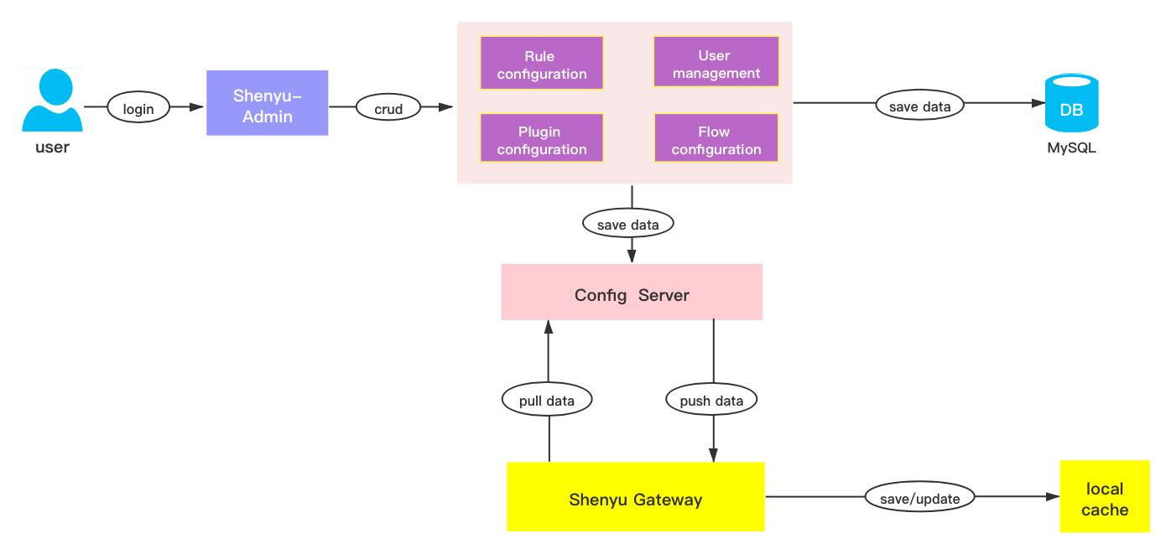
Data Sync
https://shenyu.apache.org/docs/next/quick-start/quick-start-http

Slide 28
Deploy shenyu-bootstrap
https://shenyu.apache.org/docs/next/deployment/deployment-local
curl -X GET http://localhost:9195/http/order/findById?id=123

Slide 29
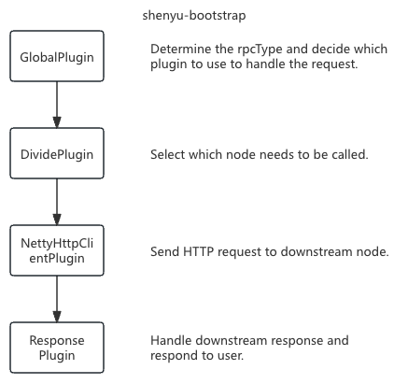
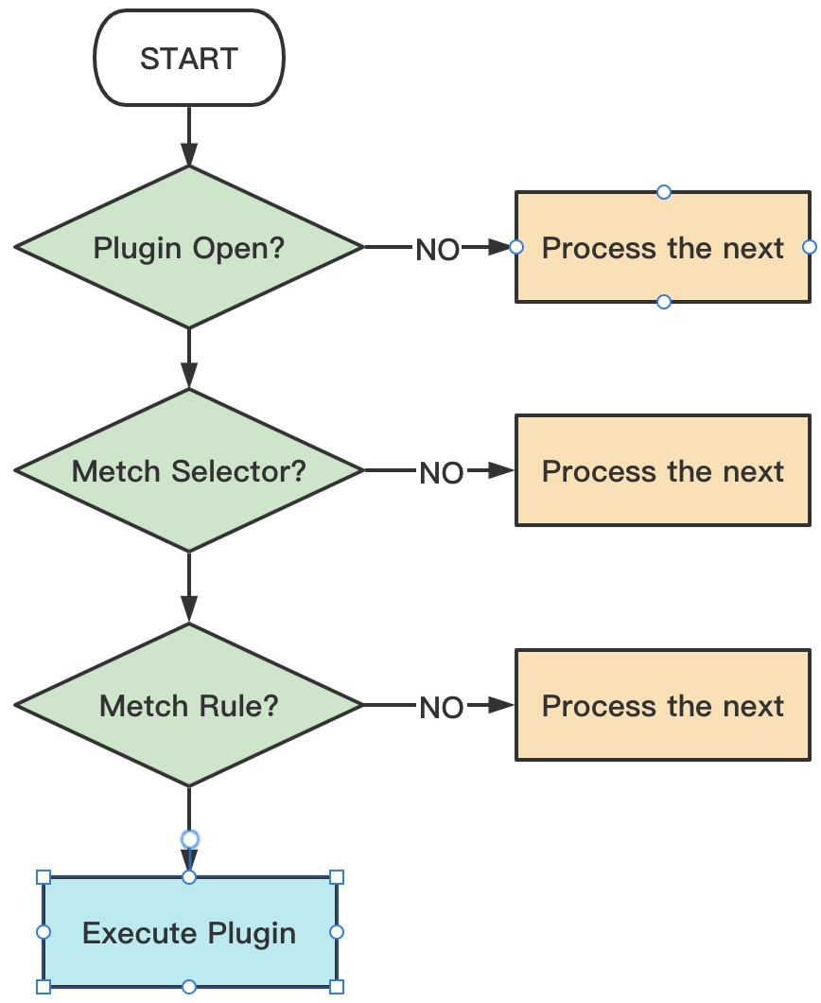
Runtime in shenyu-bootstrap

Slide 30
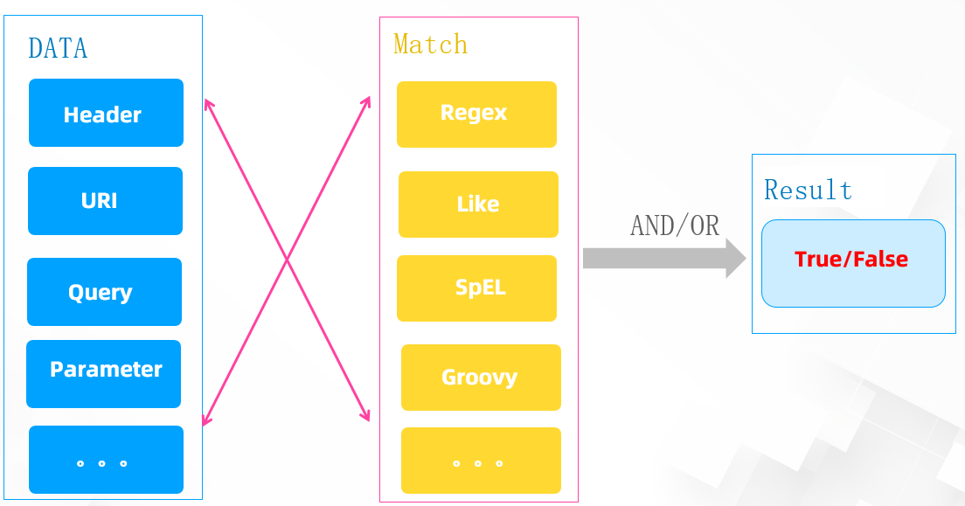
How to Match
curl -X GET http://localhost:9195/http/order/findById?id=123

Slide 31
Communication

Slide 32
Pass Args to Another Language
public class RustWasmPlugin extends AbstractWasmPlugin {
protected Map<String, Func> initWasmCallJavaFunc(final Store<Void> store) {
Map<String, Func> funcMap = new HashMap<>();
funcMap.put("get_args", WasmFunctions.wrap(store, WasmValType.I64, WasmValType.I64, WasmValType.I32, WasmValType.I32,
(argId, addr, len) -> {
ByteBuffer buf = super.getBuffer();
String config = "hello from java " + argId;
for (int i = 0; i < len && i < config.length(); i++) {
buf.put(addr.intValue() + i, (byte) config.charAt(i));
}
return Math.min(config.length(), len);
}));
return funcMap;
}
}

Slide 33
Pass Args to Another Language
// rust code
#[link(wasm_import_module = "shenyu")]
extern "C" {
fn get_args(arg_id: i64, addr: i64, len: i32) -> i32;
}
#[no_mangle]
pub unsafe extern "C" fn execute(arg_id: i64) {
let mut buf = [0u8; 32];
let buf_ptr = buf.as_mut_ptr() as i64;
// get arg from java
let len = get_args(arg_id, buf_ptr, buf.len() as i32);
let java_arg = std::str::from_utf8(&buf[..len as usize]).unwrap();
eprintln!("rust side-> recv:{}", java_arg);
}

Slide 34
Pass Result to Java
public class RustWasmPlugin extends AbstractWasmPlugin {
protected Map<String, Func> initWasmCallJavaFunc(final Store<Void> store) {
Map<String, Func> funcMap = new HashMap<>();
funcMap.put("put_result", WasmFunctions.wrap(store, WasmValType.I64, WasmValType.I64, WasmValType.I32,
(argId, addr, len) -> {
ByteBuffer buf = super.getBuffer();
byte[] bytes = new byte[len];
for (int i = 0; i < len; i++) {
bytes[i] = buf.get(addr.intValue() + i);
}
String result = new String(bytes, StandardCharsets.UTF_8);
LOG.info("java side->" + result);
}));
return funcMap;
}
}

Slide 35
Pass Result to Java
// rust code
#[link(wasm_import_module = "shenyu")]
extern "C" {
fn put_result(arg_id: i64, addr: i64, len: i32);
}
#[no_mangle]
pub unsafe extern "C" fn execute(arg_id: i64) {
// pass rust result to java
let rust_result = "rust result".as_bytes();
let result_ptr = rust_result.as_ptr() as i64;
put_result(arg_id, result_ptr, rust_result.len() as i32);
}

Slide 36
Extention

Slide 37
Use RustHttpClientPlugin
1. Add dependency to ${shenyu}/shenyu-bootstrap/pom.xml
<dependency>
<groupId>org.apache.shenyu</groupId>
<artifactId>shenyu-examples-plugin-wasm</artifactId>
<version>${shenyu.version}</version>
</dependency>
2. Then rebuild and restart shenyu-bootstrap
see PR：https://github.com/apache/shenyu/pull/5595

Slide 38
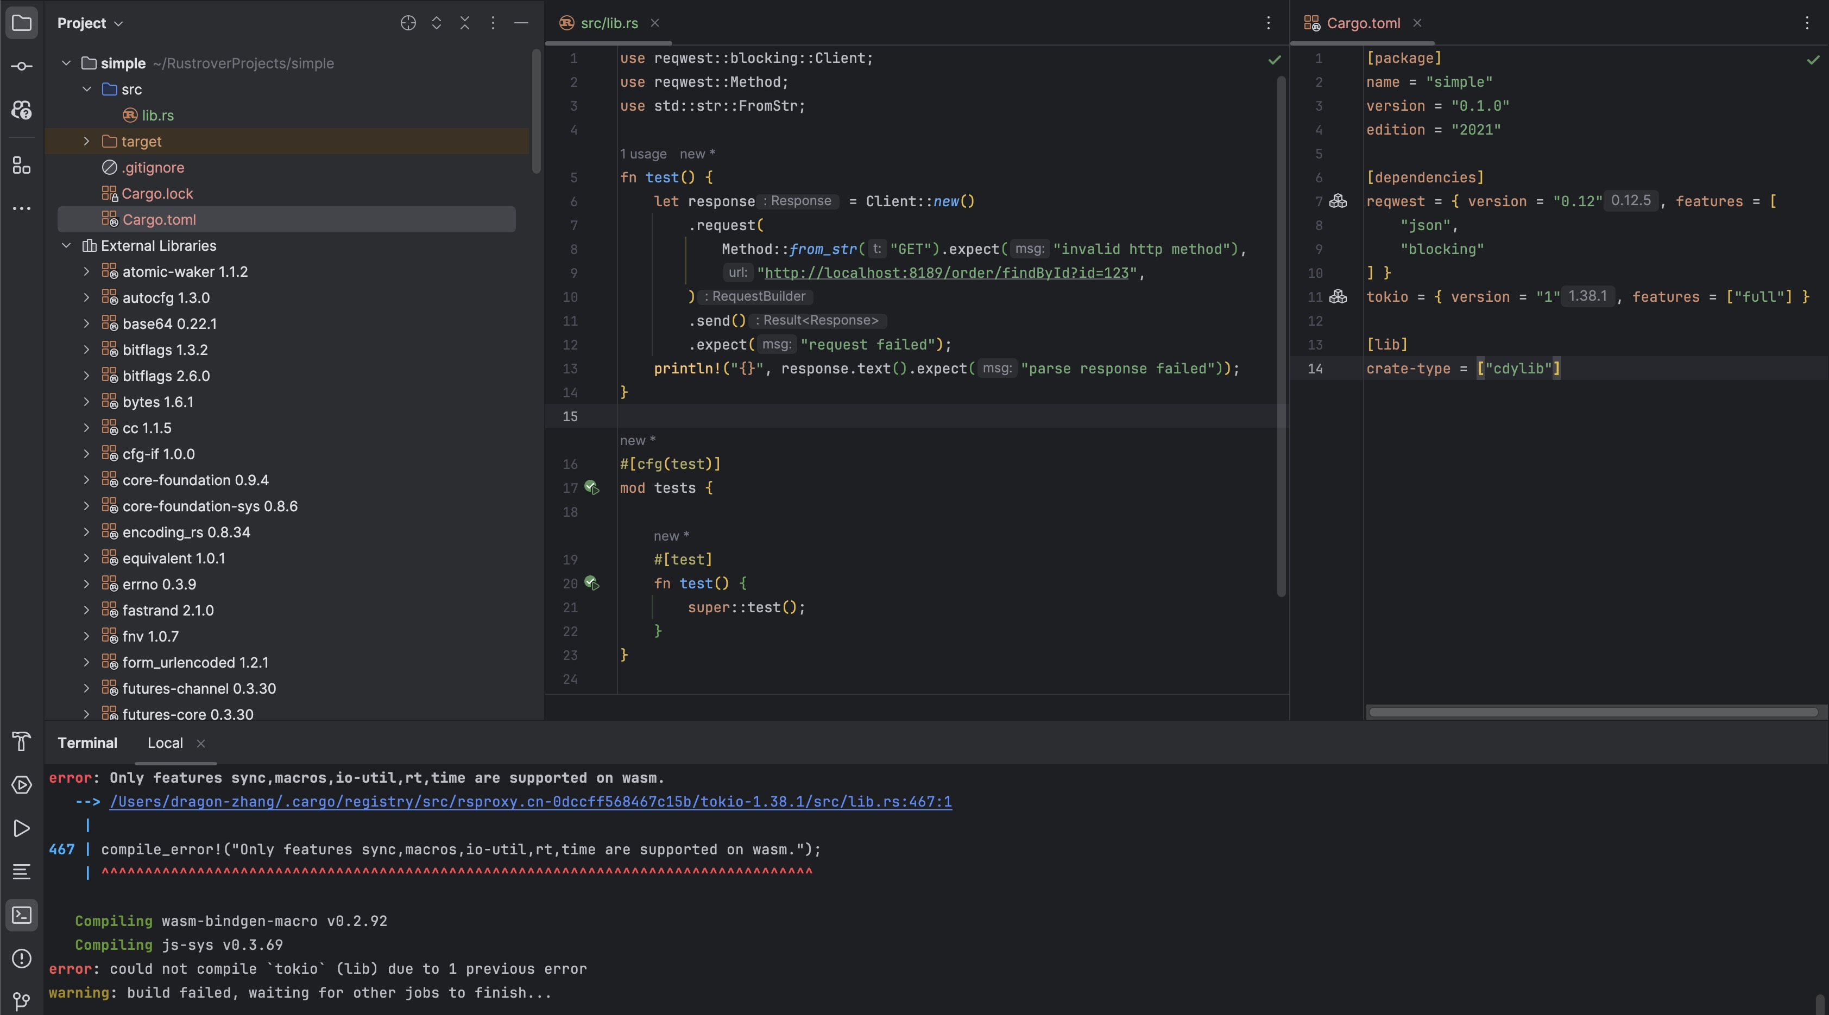
Flop
The Rust crates does not fully support WASI.

Slide 39
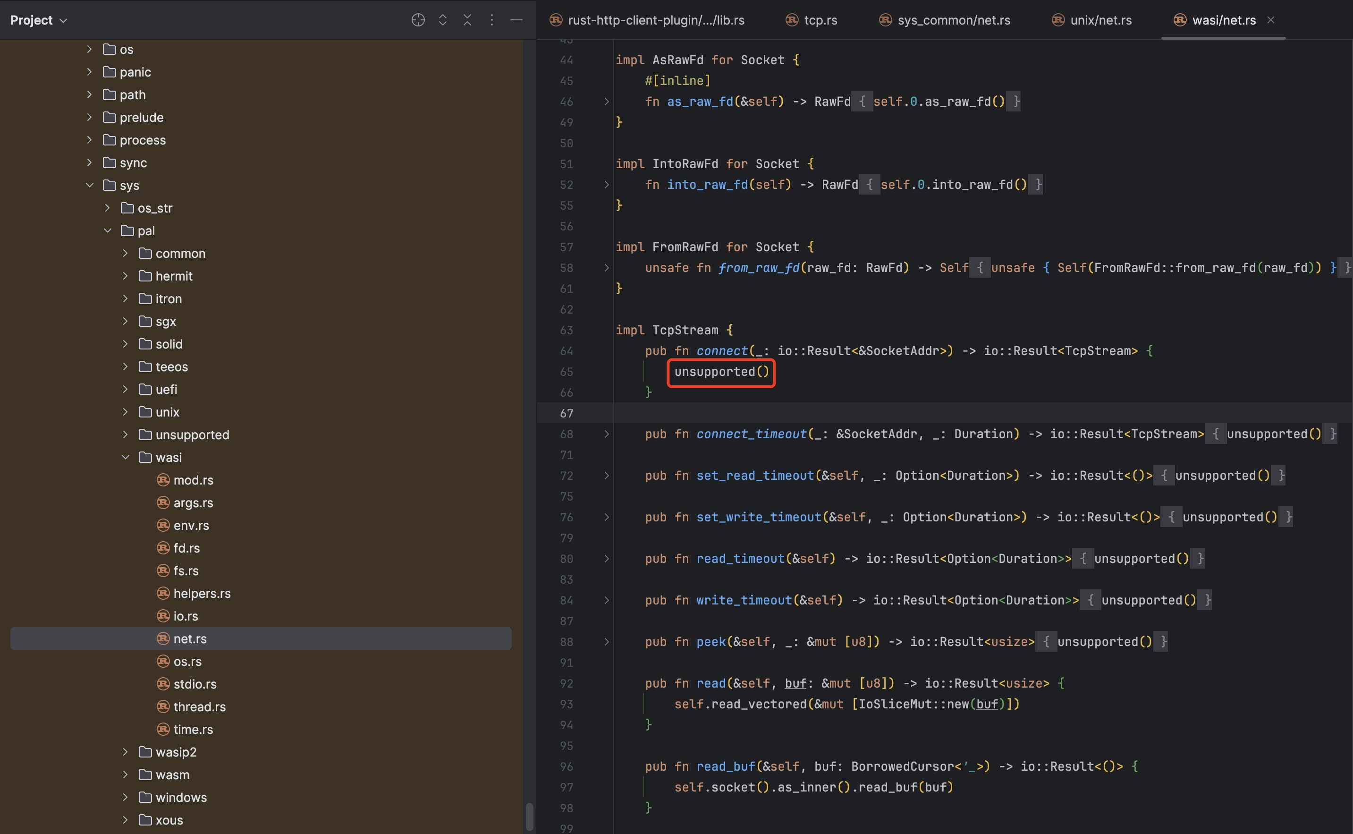
Flop
The Rust stdlib does not fully support WASI.

Slide 40
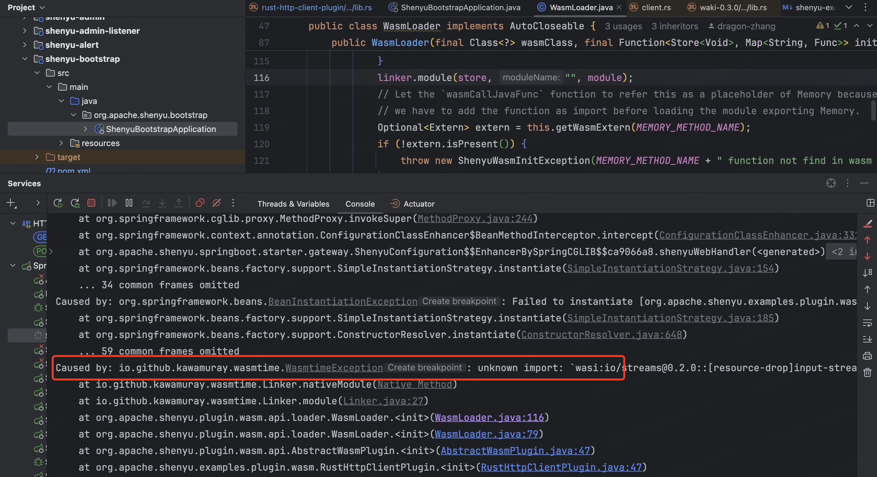
Flop
Unable to load the WASM file.

Slide 41
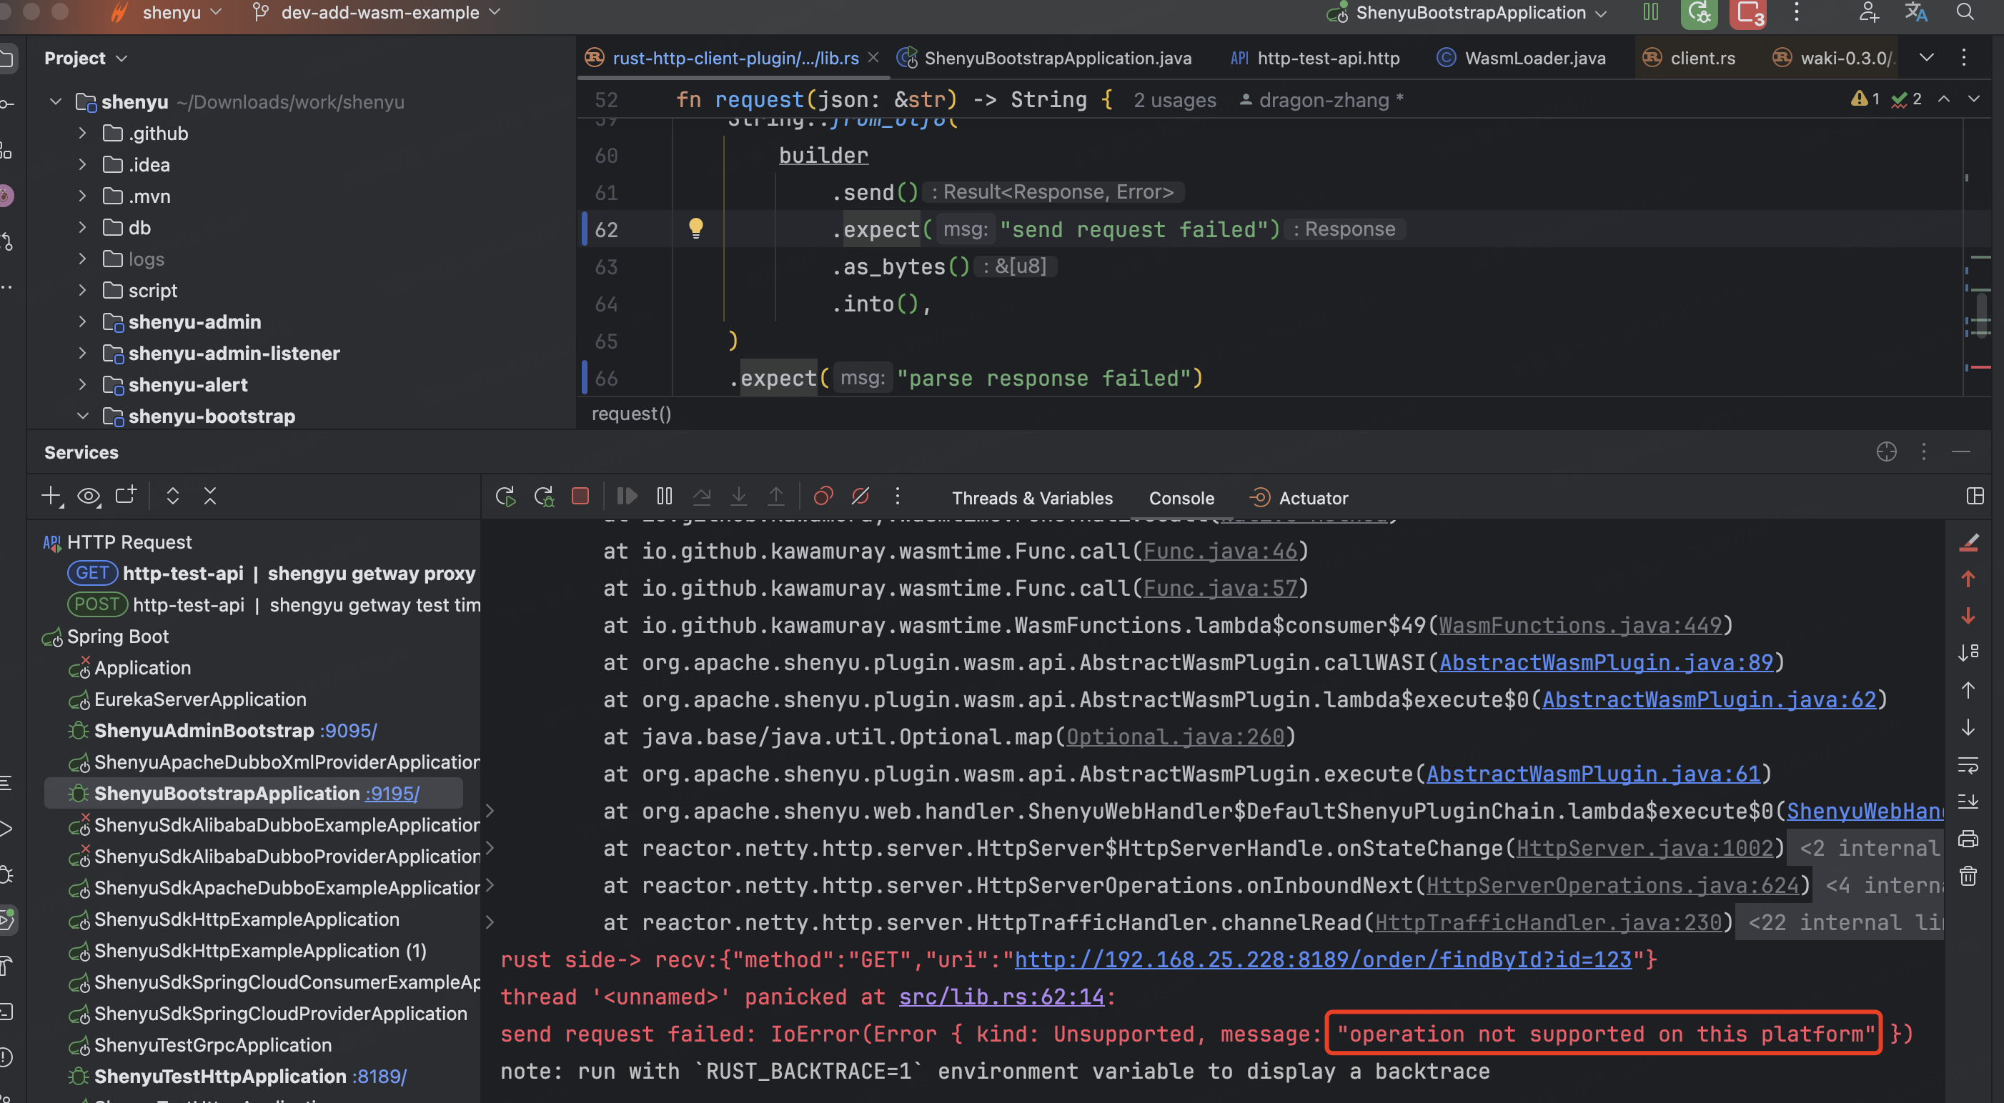
Flop
The WASM file did not run as expected.

Slide 42
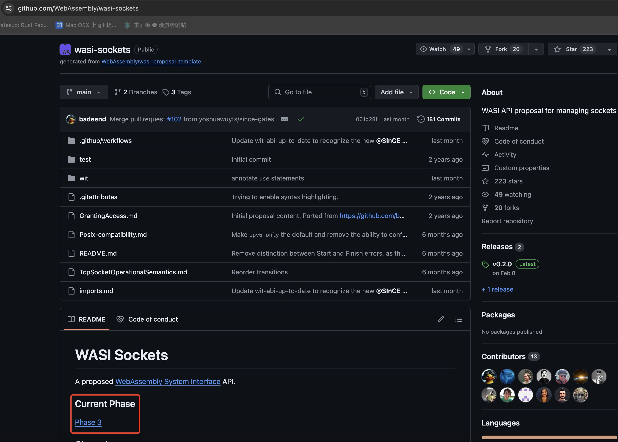
Future WASI
//

Slide 43
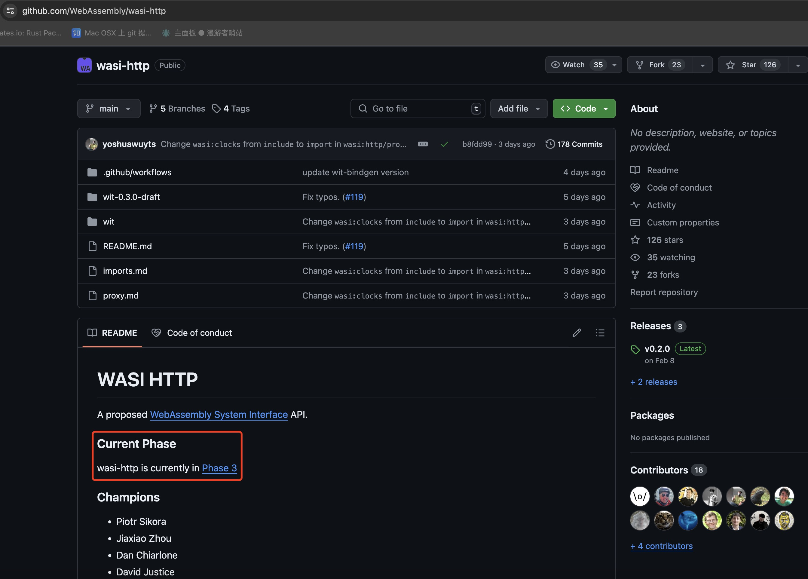
Future WASI
//

Slide 44
Question&Answer
The links to friendship projects are as follows:
https://github.com/acl-dev/open-coroutine
https://github.com/acl-dev/acl
https://github.com/alibaba/arthas
https://github.com/bytedance/monoio
https://github.com/dromara/dynamic-tp
https://github.com/apache/dubbo-spi-extensions

Slide 45
Thanks
zhangzicheng@apache.org
https://github.com/loongs-zhang/ACOCA2024-PlayWithWASM

